Slide 1



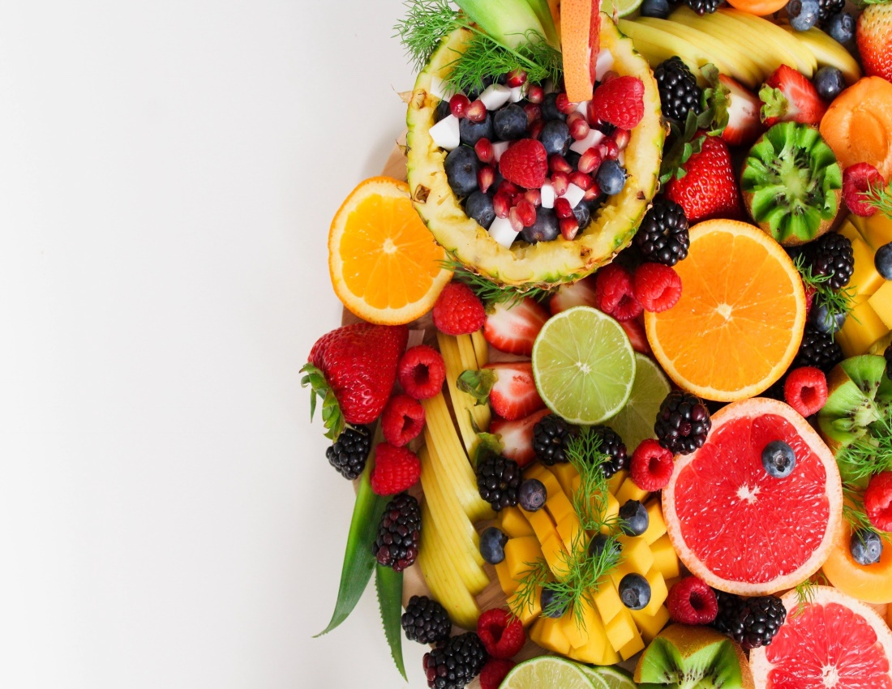
Kwikmart
Search here… .
Home Category Product Deal Contact
Search here……
YOUR DAILY
NEED
PRODUCTS
Get started

Slide 2
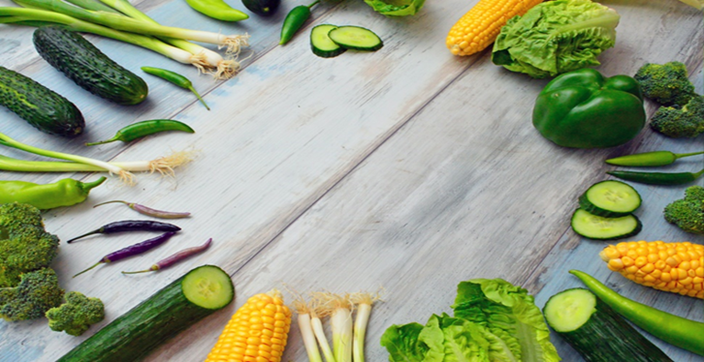
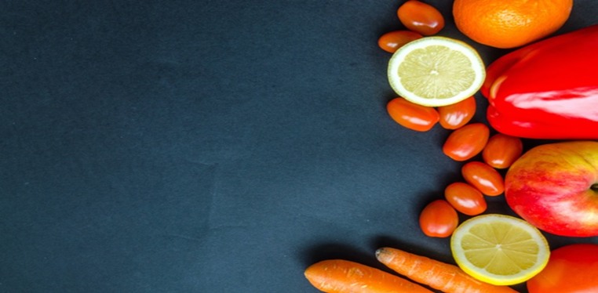

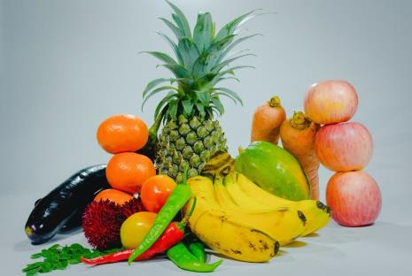
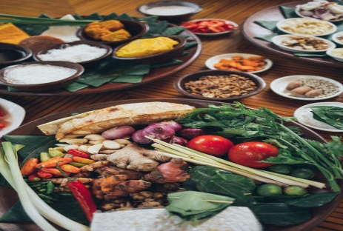
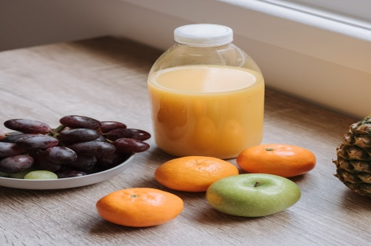
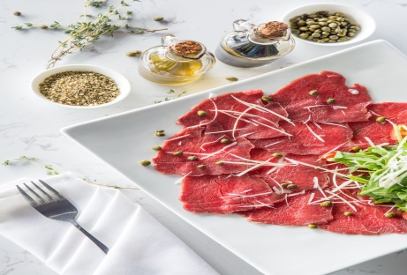

Special offer
Up to 55% OFF
Special offer
Up to 55% OFF
Check Out
SHOP BY CATEGORY
FRUITS
UPTO 30%OFF
VEGETABLE
UPTO 30%OFF
JUICES
UPTO 30%OFF
MEAT
UPTO 30%OFF
Shop Now

Slide 3
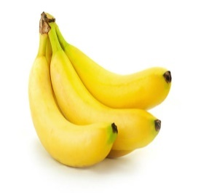
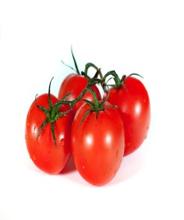
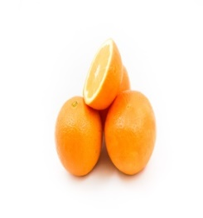



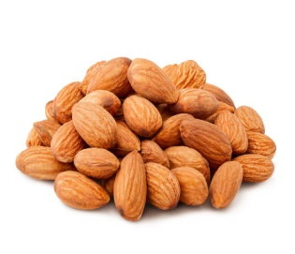
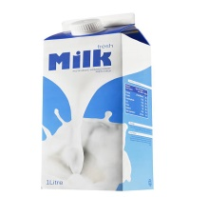
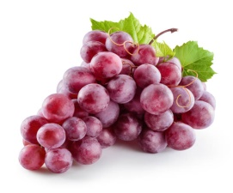
LATEST PRODUCTS
-35%
-45%
-56%
Organic Banana
Organic tomato
Organic orange
₹58.5 ₹90
₹44 ₹80
₹44 ₹100
Quantity :
1
/kg
Quantity :
1
/kg
Quantity :
1
/kg
Add to Cart
Add to Cart
Add to Cart
-18%
-34%
-13%
Natural milk
Organic Grapes
Natural Almonds
₹49.2 ₹60
₹59.4 ₹90
₹435 ₹500
Quantity :
1
/kg
Quantity :
1
/kg
Quantity :
1
/kg
Add to Cart
Add to Cart
Add to Cart

Slide 4
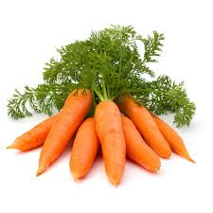
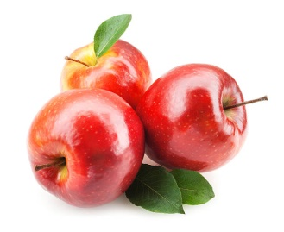
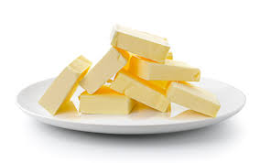
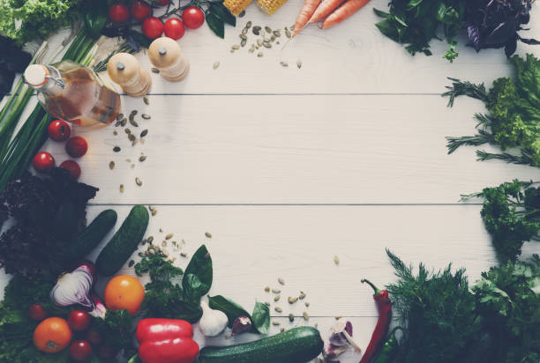
-35%
-35%
-35%
Natural butter
Organic carrot
Organic apple
₹58.5 ₹90
₹58.5 ₹90
₹58.5 ₹90
Quantity :
1
/kg
Quantity :
1
/kg
Quantity :
1
/kg
Add to Cart
Add to Cart
Add to Cart
Deal of the day
13
4
16
5
Day
hours
minutes
seconds
Get The Deal

Slide 5
CONTACT US
name
Email
Phone number
Subject
message
Send Message

Slide 6
Subscribe for the latest update
Enter your email
SUBSCRIBE
Kwikmart
Contact Us
India
USA
Russia
Japan
France
Quick links
Home
Category
Product
Deal
Contact
Download Apps
Google app
Windows XP
App store

